Slide 1
Procedural Modeling of Complex Systems
Bernhard Rainer¹ and Silvester Farda¹
and Algorithms
Vienna University of Technology
² <insert 2nd affiliation (institute) here>
<insert 2nd affiliation (university) here>

Slide 2
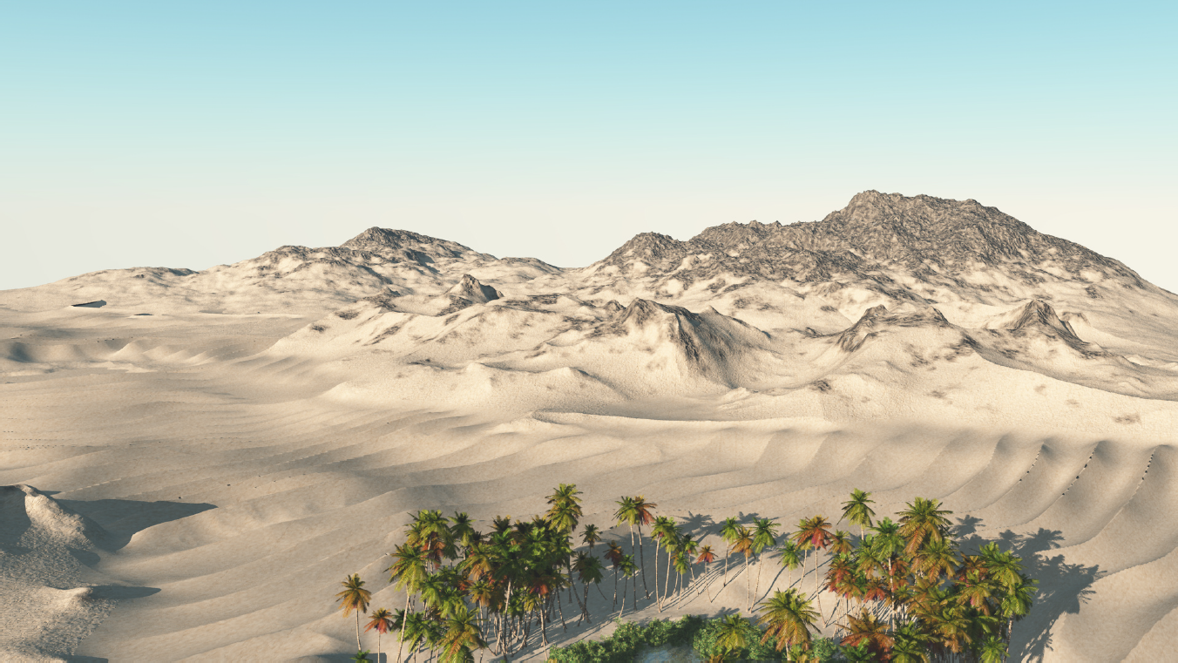
Motivation

Slide 3
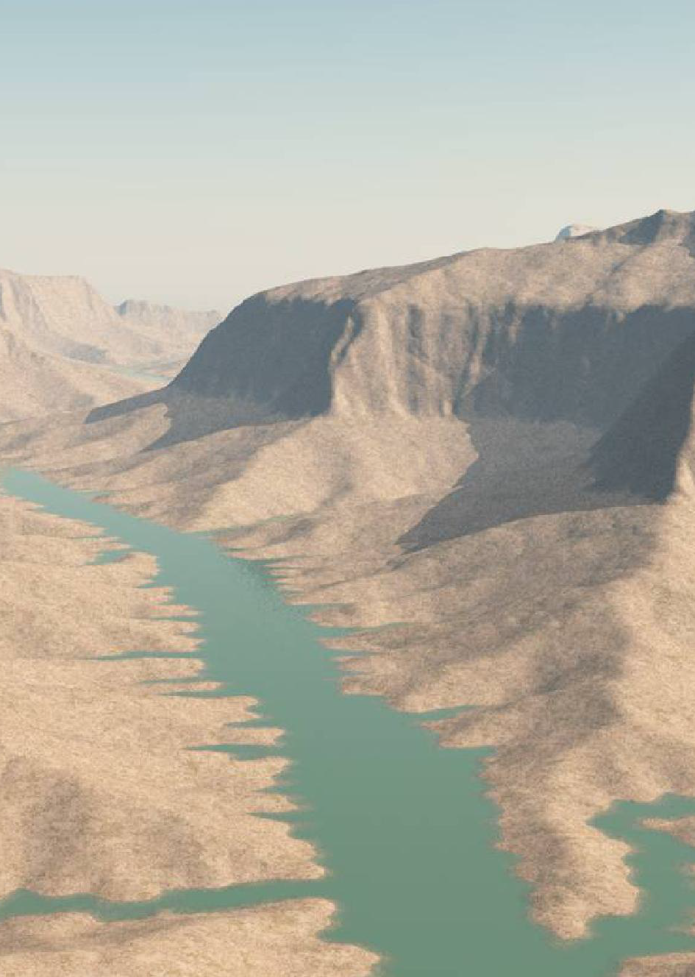
Motivation
Systems too complex to model by hand
Create physically plausible systems
Create realistic systems
Create good looking systems

Slide 4
Outline
The quick brown fox jumps over the lazy dog
The quick brown fox jumps over the lazy master
The quick brown fox jumps over the lazy dog
The quick brown fox jumps over the lazy dog
The quick brown fox jumps over the lazy master
The quick brown fox jumps over the lazy dog

Slide 5
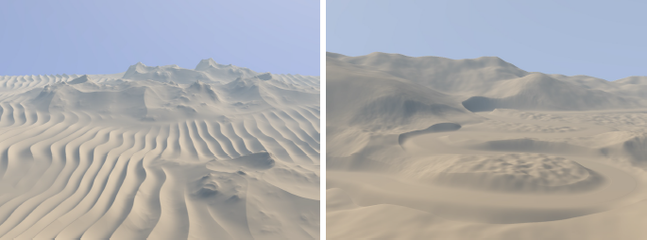
Terrain Modeling from Feature Primitives

Slide 6
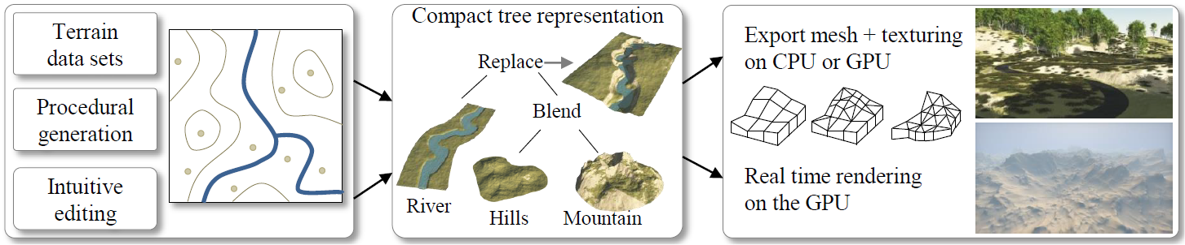
Terrain Modeling from Feature Primitives
Interprets terrain as combination of primitives
Uses a construction tree
Leave nodes are primitives
Inner nodes are operators

Slide 7
Terrain Modeling from Feature Primitives
Feature Primitives
Describe landmark features
Different primitive types:
Skeletal primitives
Contour primitives
Image primitives (e.g. heightmaps)
Have a weight function

Slide 8
Terrain Modeling from Feature Primitives
Skeletal Primitives
Disc primitive
radius, center, noise function
Used for peculiar mountains, etc.
Curve primitive
Curve skeleton, set of cross sections
Used for rivers, roads, etc.

Slide 9
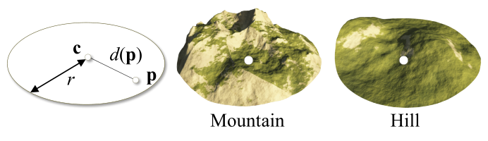
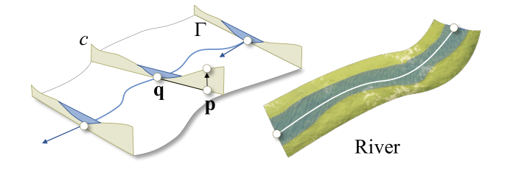

Slide 10
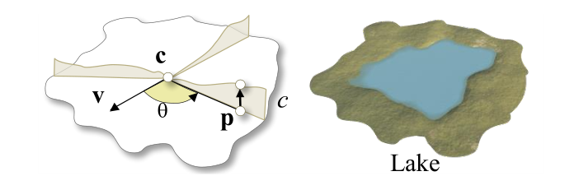
Terrain Modeling from Feature Primitives
Contour Primitives
Curve around center, set of profile curves describe the elevation in radial direction
Used for more complex features, like lakes

Slide 11
Terrain Modeling from Feature Primitives
Operators
Combine several primitives using their weight functions
Addition Operator
Blend Operator
Replace Operator
Warp Operator

Slide 12
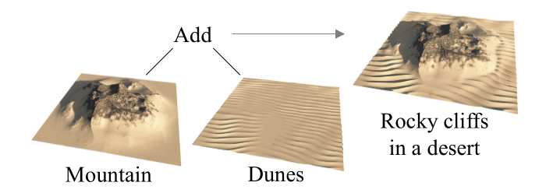
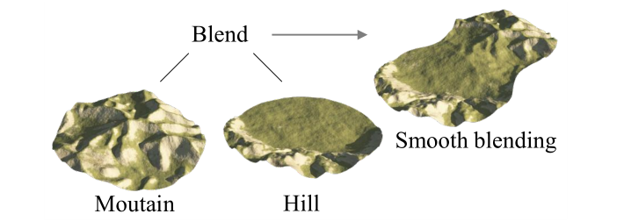
Terrain Modeling from Feature Primitives

Slide 13
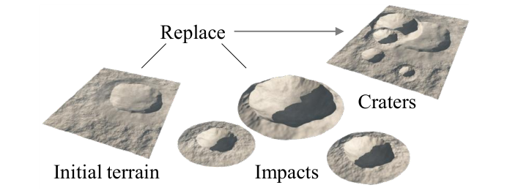
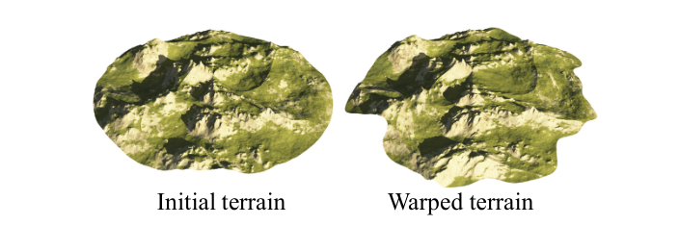
Terrain Modeling from Feature Primitives

Slide 14
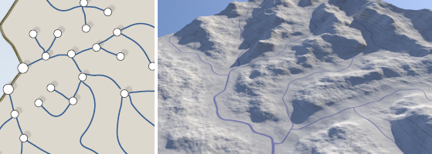
Terrain Generation Using Procedural Models Based on Hydrology
Create terrain from river network
Generate river network using probabilistic approach
Iteratively grow river network

Slide 15
Terrain Generation Using Procedural Models Based on Hydrology
River network can be interpreted as graph, whose nodes are:
Spring
Fork
Mouth
Each node has:
Position
Priority Index

Slide 16
Terrain Generation Using Procedural Models Based on Hydrology
River network generation
Node selection
Node expansion
Node creation
Repeat until all nodes are connected

Slide 17
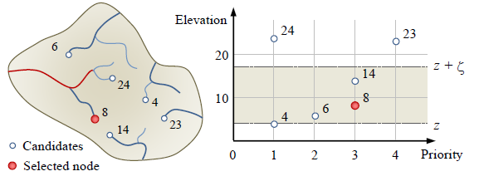
Terrain Generation Using Procedural Models Based on Hydrology
Node Selection
Candidate nodes are nodes that can be expanded from
Select node from candidate nodes based on heuristic that takes into account the elevation and priority index

Slide 18
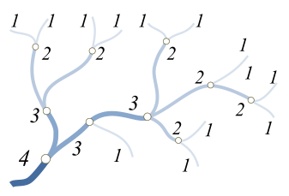
Terrain Generation Using Procedural Models Based on Hydrology
Node Expansion
Create new node
Type defined by:
Probabilities (supplied from user
Horton-Strahler number
Node Creation
Insert created node
Check for correctness

Slide 19
Terrain Generation Using Procedural Models Based on Hydrology
Primitive Generation
Create Voronoi diagram of graph
For each Voronoi cell:
Create junctions between water inflows first, then connect to outflow(s)
Junction angles is influenced by waterflow
Use predefined types of water-courses depending on waterflow and elevation
Use Horthon-Strahler number as waterflow

Slide 20
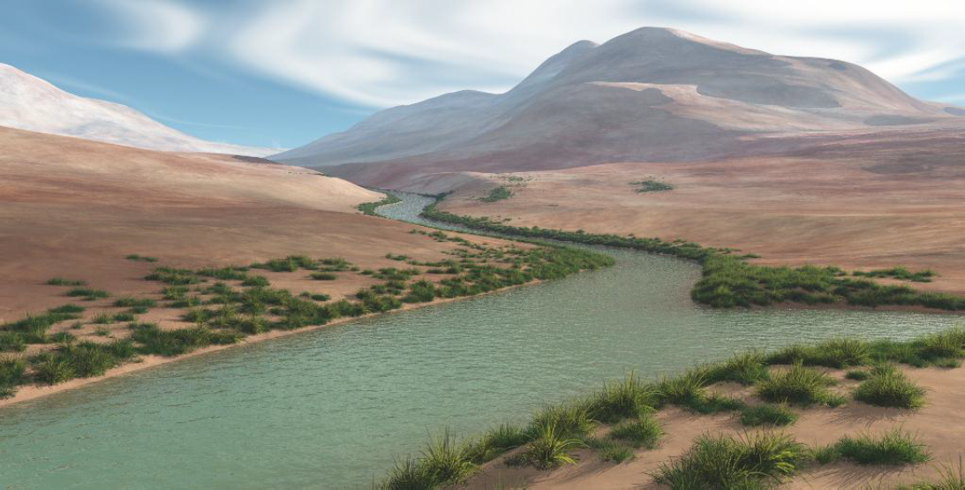
Terrain Generation Using Procedural Models Based on Hydrology
Compute heightfield with Poisson distribution, influenced by distance to watershed
Insert primitives into construction tree

Slide 21
Large Scale Terrain Generation from Tectonic Uplift and Fluvial Erosion
Terrain = result from combined action of tectonic uplift and erosion
Uplift map = speed at which terrain is elevated by tectonics
Fluvial erosion = erosion of bedrock material and its transportation downhill
Stream Power equation = rate of change of surface topography, controlled by uplift and erosion

Slide 22
Large Scale Terrain Generation from Tectonic Uplift and Fluvial Erosion
Algorithm
Create randomly triangulated graph
Extract set of stream trees according to current elevation
Add new arcs to stream tree from overflowing lakes
Compute drainage area and local slope
Solve stream power equation
Stop when stabilization criterion is met

Slide 23
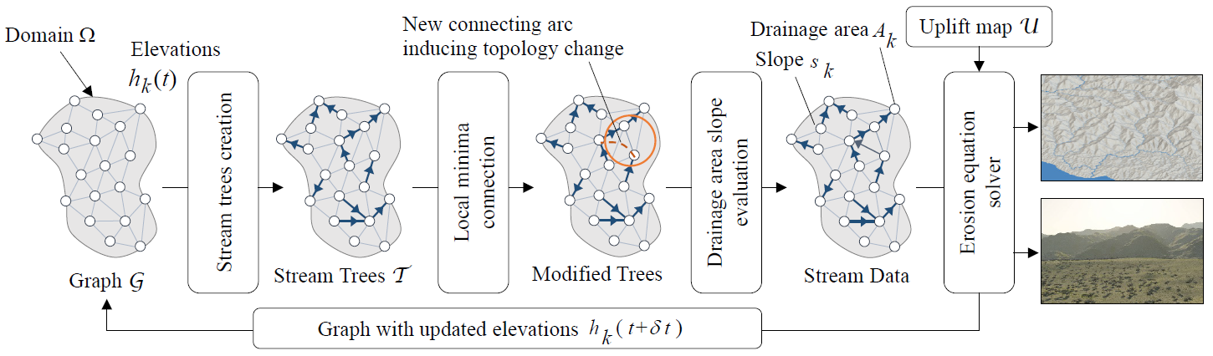
Large Scale Terrain Generation from Tectonic Uplift and Fluvial Erosion

Slide 24
Large Scale Terrain Generation from Tectonic Uplift and Fluvial Erosion
Repeat for multiple time steps, with modified stream tree as input
Use proper time steps and scales.
Terrain size: 50x50 km²
Max. tectonic uplift = 5.0 * 10⁻⁴ meters per year
Simulation time step: 2.5 * 10⁵ years
Create Feature primitives from final graph

Slide 25
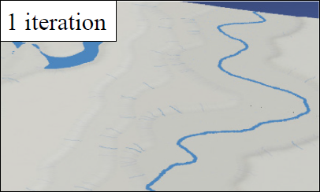
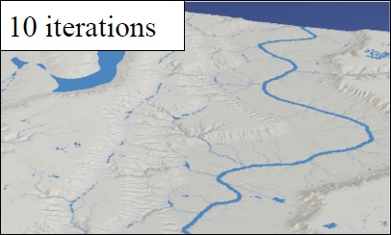
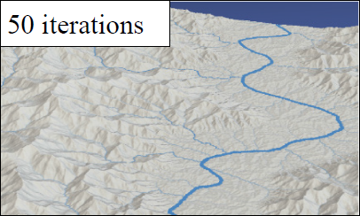
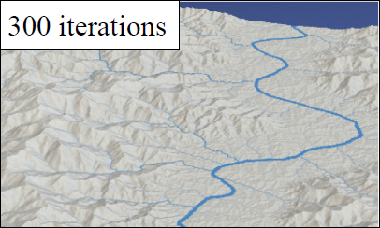
Large Scale Terrain Generation from Tectonic Uplift and Fluvial Erosion

